Slide 1
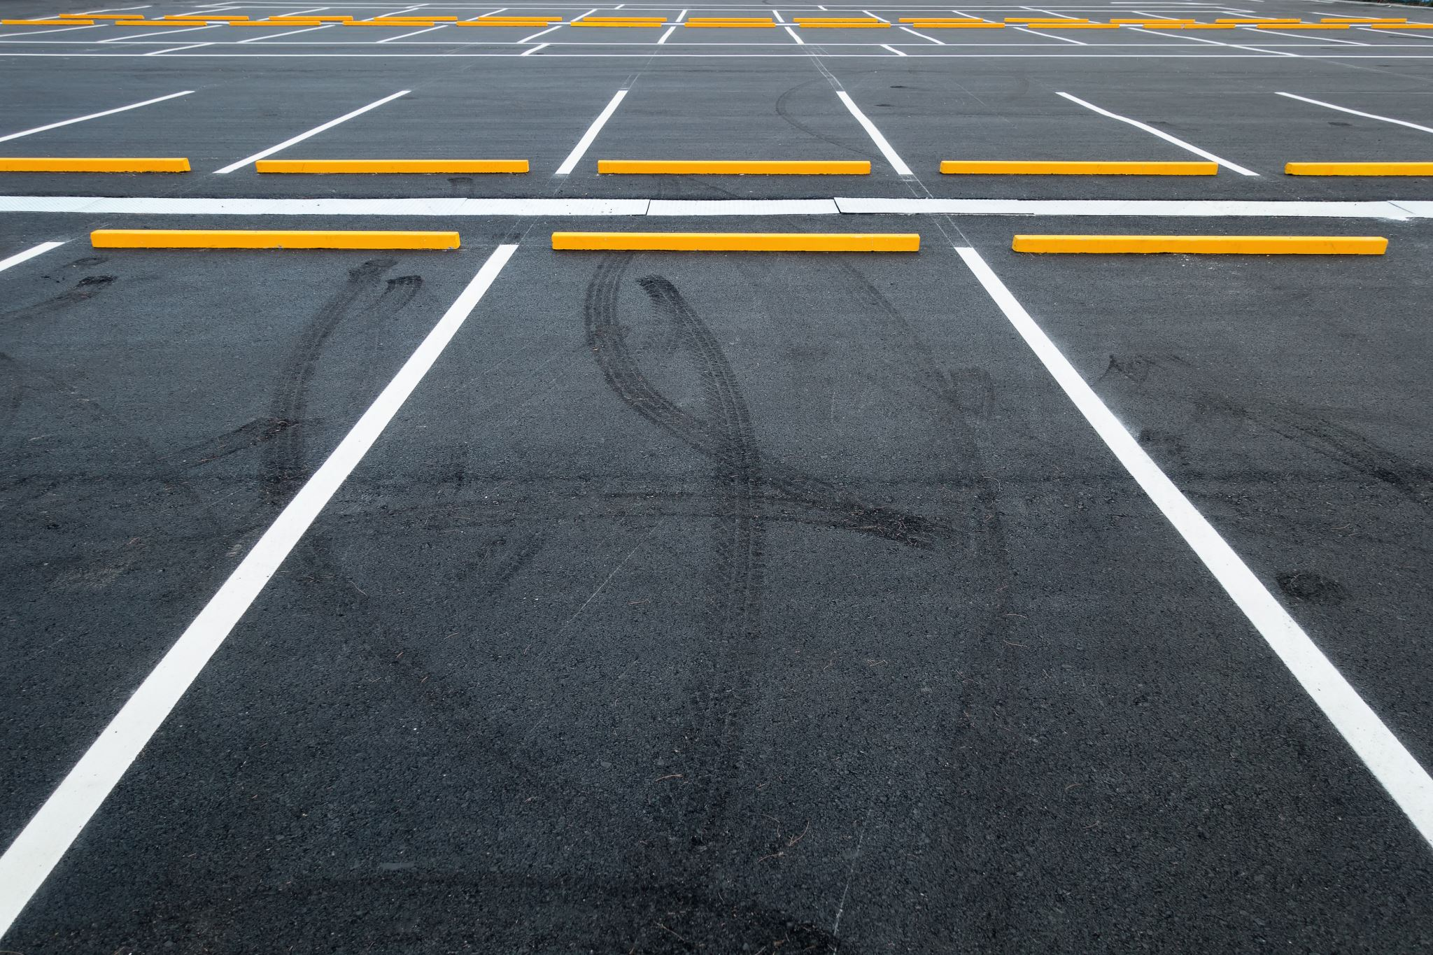
Parking Availability System
Beta Presentation Milestone
The ParKings | Erik Meurrens Benjamin Simonson Ryan Jalloul Evan Tobon Samer Khatib
CEN4908C – Computer Engineering Design 2
Notes:
Something like:
“Hey everyone, my name is [NAME], we are the ParKings, and this is our project, the Parking Availability System.”

Slide 2

Context
UF lacks easily available parking resources
Parking difficulties cause drivers stress and frustration, wastes time, and creates traffic congestion.
Parking Availability System (PAS)
A low-cost, hardware/software system for parking information for facilities on campus
Features:
Vehicle Detection
License Plate Recognition
Database with Lot and Car Information
Real-time Parking Information on Mobile App

Slide 3
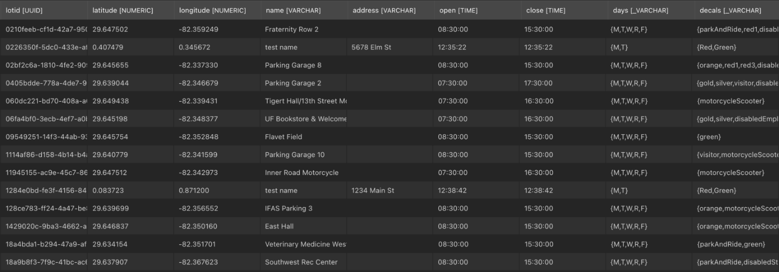
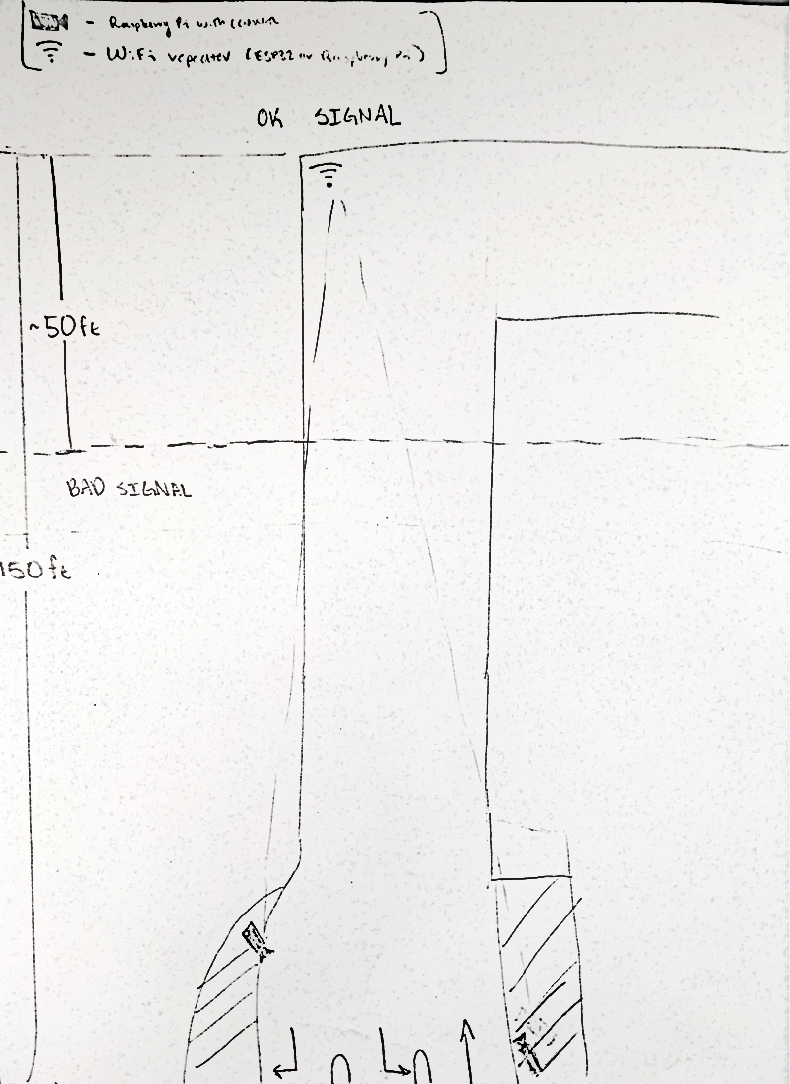
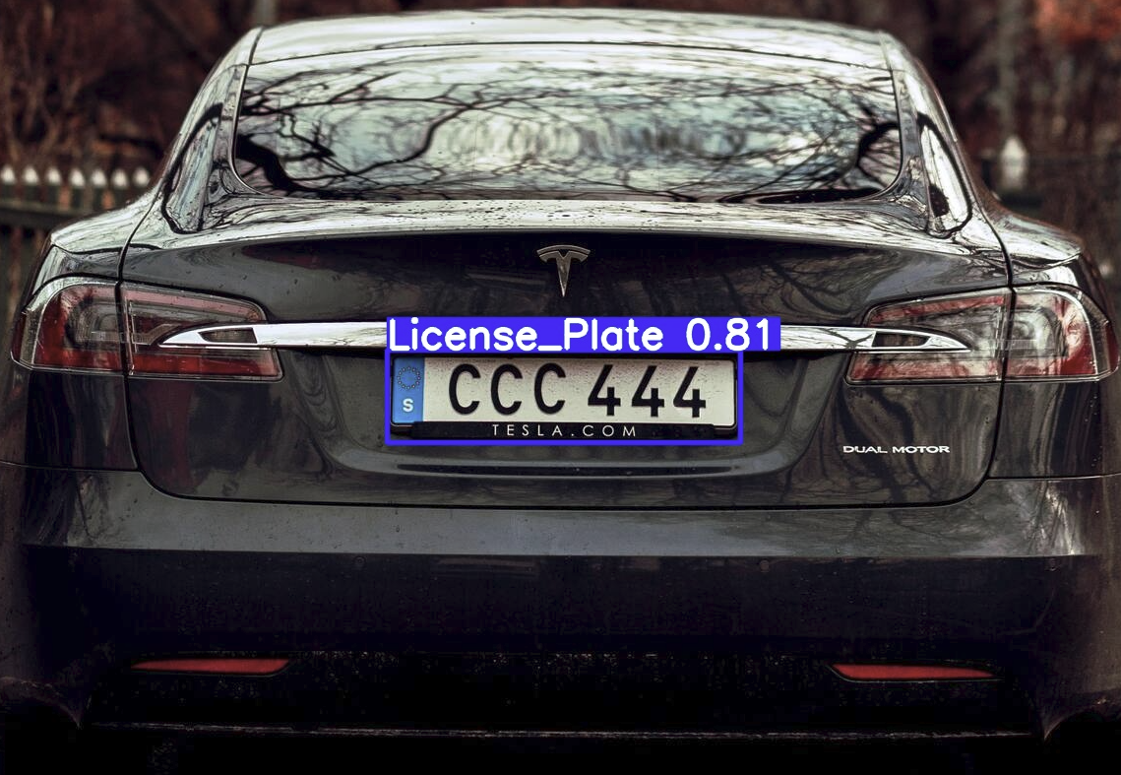
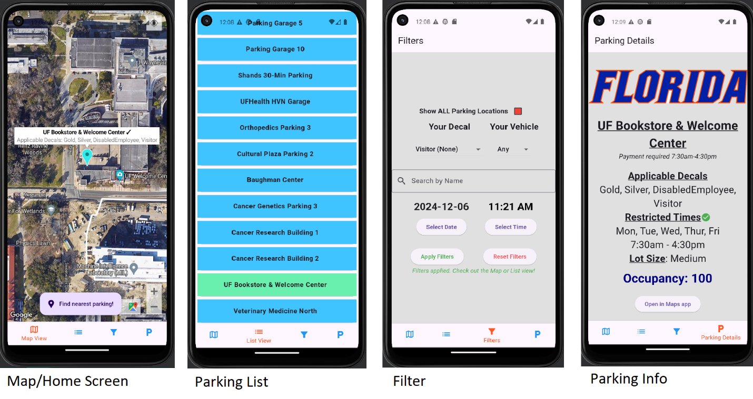
Alpha Completed Work
Alpha Build (01/10/2025 - 01/28/2025)
Researching, planning and deciding on a solution to resolve WiFi dead zone in pilot garage: ESP32 repeater USB WiFi modem for Raspberry Pi
Implemented YOLOv11n license plate detection model on Raspberry Pi
Implemented API communication between Raspberry Pi and AWS
Preliminary configuration script implementation for Raspberry Pi set up: System packages Python virtual environment
Developed test plan for testing license plate recognition, backend API functionality, mobile app functionality, hardware performance, network connectivity

Slide 4
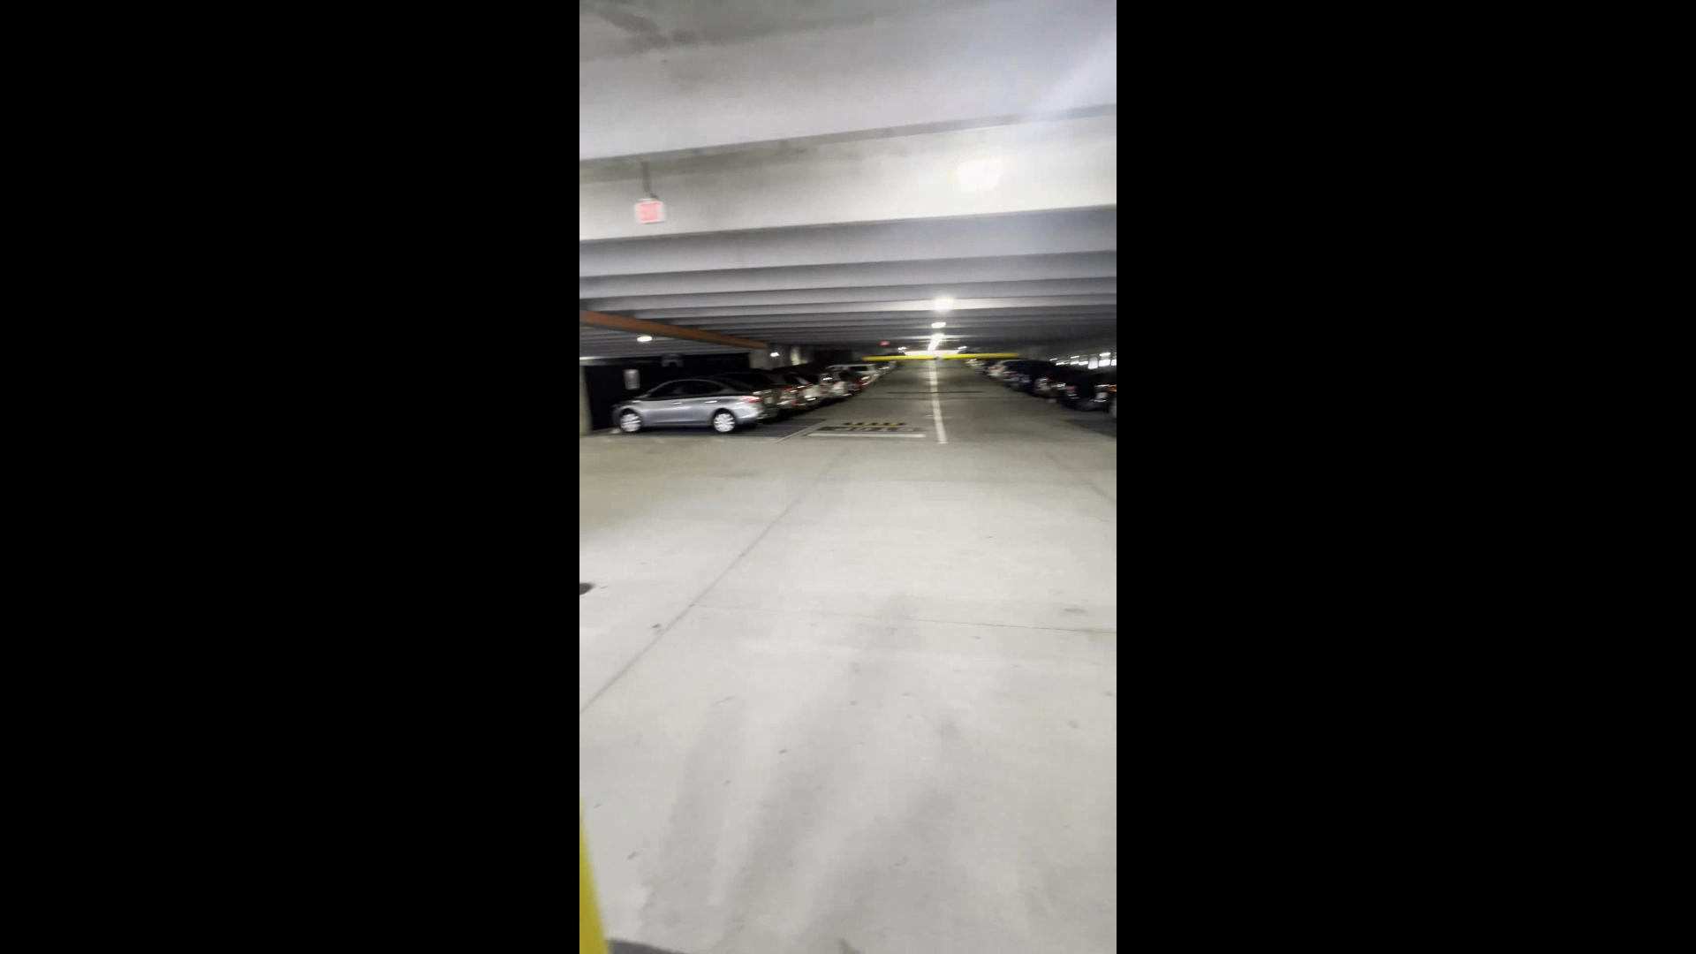
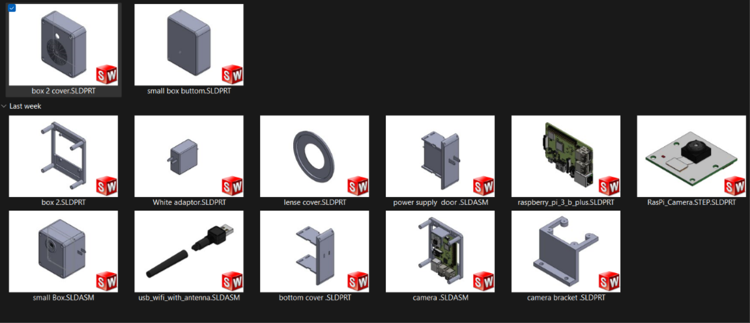
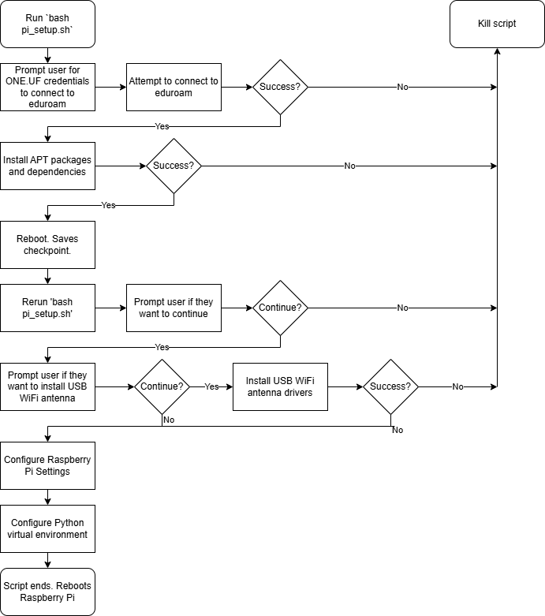
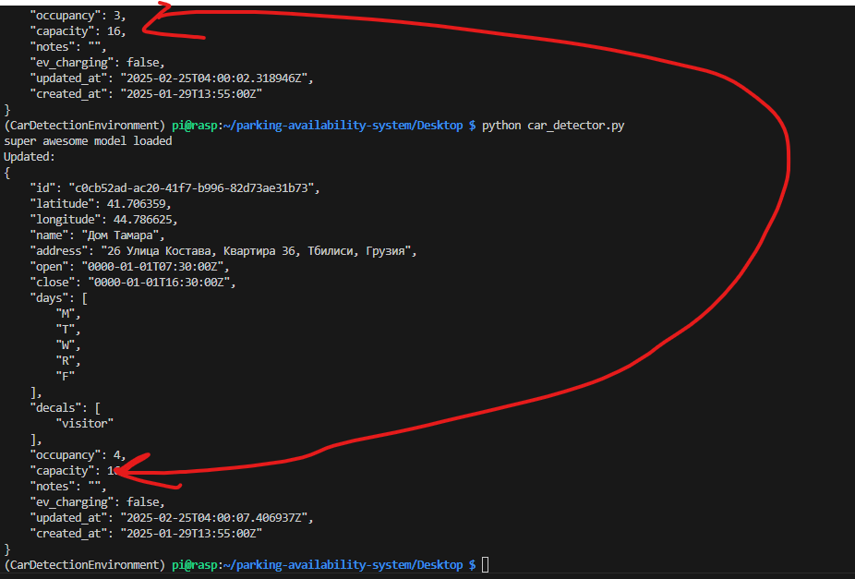
Beta Completed Work
Input Size | MinTime | MeanTime | MaxTime | MaxFPS | MeanFPS | MinFPS
640x384 | 203.4 | 271.14 | 373.4 | 4.916 | 3.688 | 2.678
Modem Type | Average Bit Rate (Mb/s) | Average Link Quality | Average Received Signal Strength (dBm)
On-board (5 GHz) | 54.53333 | 79% | -55
Antenna (5 GHz) | 115.175 | 91% | -46.3333
Beta Build (02/02/2025 - 02/21/2025)
Designing and printing of the second Raspberry Pi housing iteration Smaller size, better ventilation, persistent power (no battery, wall wart power supply)
Work on ESP32 network repeater access point
Completion of Raspberry Pi configuration script: Documentation, eduroam network onboarding, system packages, WiFi modem drivers, system settings, virtual environment, script error control
Preliminary car detection algorithm direction configuration
Testing USB WiFi modem, on-board modem, and network connectivity
Testing license plate detection inference speed and real-world functionality on Raspberry Pi
Adjustments to testing plan

Slide 5
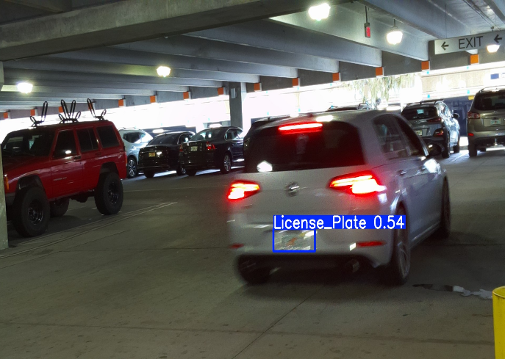
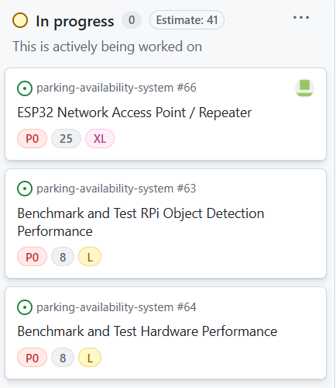
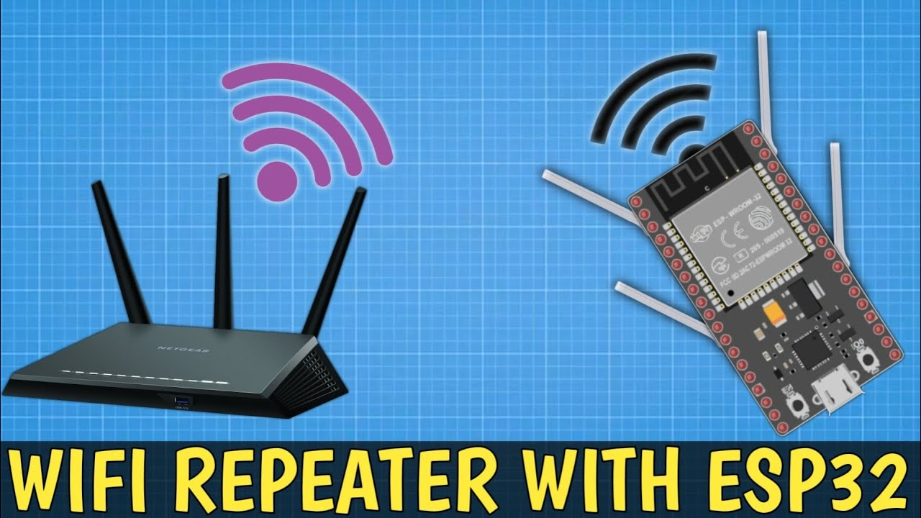
In-Progress Work
Continued Testing
Connectivity tests for modem(s), ESP32 repeater, and stability at pilot garage
License plate detection performance tests
Logging
Inference speed and accuracy scores
Augmenting camera configuration to enhance functionality
Mobile app user testing
ESP32 Repeater
ESP32 is currently configured as an access point, but needs improvements to the UF eduroam
connection
More testing is needed to ensure that the range of the ESP32 will not impact performance

Slide 6
Future Work

Slide 7
Deliverable Plan
The ESP32 will be configured with different wifi channels to maximize range, and then testing will follow to ensure that it can reach the required distance
Tests will be developed by writing unit tests which will ensure full functionality of the license plate detection model, the connectivity between all devices within the system, and the mobile app
The baseline hardware performance will be recorded, and we will begin adjusting settings to maximize performance, such as the camera shutter speed and the confidence of the object detection model
Further adjustments and developments will be made to the housing and the imaging caching process

Slide 8
Demonstration

Slide 9
Questions?

